Slide 1
اعمال رياضی با اعداد

Slide 2
اعمال رياضي باينري: جمع
قوانين: مانند جمع دسيمال
با اين تفاوت که 1+1 = 10 ← توليد نقلي
0+0 = 0(c0) (sum 0 with carry 0)
0+1 = 1+0 = 1(c0)
1+1 = 0(c1)
1+1+1 = 1(c1)

Slide 3
اعمال رياضي باينري: جمع
قوانين: مانند جمع دسيمال
با اين تفاوت که 1+1 = 10 ← توليد نقلي
0+0 = 0(c0) (sum 0 with carry 0)
0+1 = 1+0 = 1(c0)
1+1 = 0(c1)
1+1+1 = 1(c1)
Carry | 1 | 1 | 1 | 1 | 1 | 0
Augend | 0 | 0 | 1 | 0 | 0 | 1
Addend | 0 | 1 | 1 | 1 | 1 | 1
Result | 1 | 0 | 1 | 0 | 0 | 0

Slide 4
سرريز (Overflow)
اگر تعداد بيت ها = n و حاصل جمع n+1 بيت نياز داشته باشد
← سرريز

Slide 5
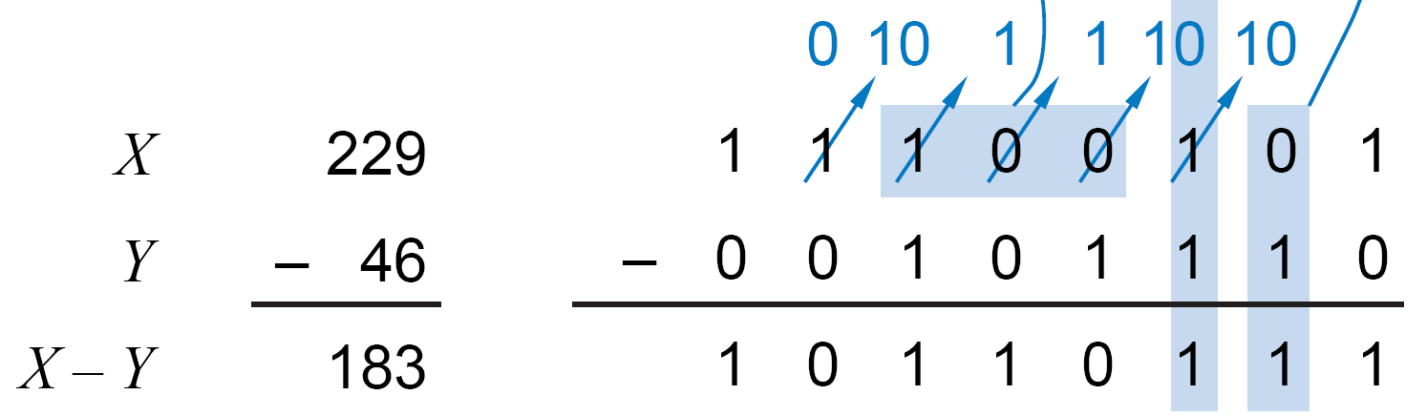
اعمال رياضي باينري: تفريق
قوانين:
0-0 = 1-1 = 0 (b0) (result 0 with borrow 0)
1-0 = 1 (b0)
0-1 = 1 (b1)
…
Borrow | 1 | 1 | 0 | 0
Minuend | 1 | 1 | 0 | 1 | 1
Subtrahend | 0 | 1 | 1 | 0 | 1
Result | 0 | 1 | 1 | 1 | 0

Slide 6
روش انجام محاسبات
الگوريتم هاي اعمال رياضي مبناي 10 را به خاطر آوريد.
آنها را براي مبناي مورد نظر تعميم دهيد.
قانون مبناي مورد نظر را به کار بريد.
براي باينري: 1+1=10

Slide 7
نمايش اعداد
نمايش اعداد مثبت:
در بيشتر سيستم ها يکسان است.
نمايش اعداد منفي:
اندازه-علامت (Sign magnitude)
مکمل 1 (Ones complement)
مکمل 2 (Twos complement)
در بيشتر سيستم ها: مکمل 2
فرض:
ماشين با کلمه هاي 4 بيتي:
← 16 مقدار مختلف قابل نمايش.
تقريباً نيمي مثبت، نيمي منفي.

Slide 8
نمايش اعداد
اندازه-علامت:
High order bit is sign: 0 = positive (or zero), 1 = negative
Three low order bits show the magnitude: 0 (000) thru 7 (111)
Number range for n bits = [-(2 ^{n-1} -1), +(2 ^{n-1} -1)]
Two representations for 0
Cumbersome addition/subtraction
Must compare magnitudes to determine sign of result

Slide 9
نمايش اعداد
مکمل 1:
N is positive number, then N is its negative 1's complement
n
N = (2 - 1) - N
Example: 1's complement of 7

Slide 10
نمايش اعداد
مکمل 1:
N is positive number, then N is its negative 1's complement
n
4
N = (2 - 1) - N
2 = 10000
-1 = 00001
1111
-7 = 0111
1000
Example: 1's complement of 7
Shortcut method:
simply compute bitwise complement
0111 -> 1000
= -7 in 1's comp.

Slide 11
نمايش اعداد
مکمل 1:
Subtraction implemented by addition & 1's complement
Still two representations of 0! This causes some problems
Some complexities in addition

Slide 12
نمايش اعداد
مکمل 2:
like 1's comp
except shifted
one position
clockwise
Only one representation for 0
One more negative number than positive number

Slide 13
نمايش اعداد
n
N* = 2 - N
مکمل 2:
Example: Twos complement of 7

Slide 14
نمايش اعداد
n
N* = 2 - N
4
2 = 10000
7 = 0111
1001 = repr. of -7
مکمل 2:
Example: Twos complement of 7
sub

Slide 15
نمايش اعداد
n
N* = 2 - N
4
2 = 10000
7 = 0111
1001 = repr. of -7
مکمل 2:
Example: Twos complement of 7
sub
Example: Twos complement of -7

Slide 16
نمايش اعداد
n
N* = 2 - N
4
2 = 10000
7 = 0111
1001 = repr. of -7
مکمل 2:
Example: Twos complement of 7
sub
4
Example: Twos complement of -7
2 = 10000
-7 = 1001
0111 = repr. of 7
sub

Slide 17
نمايش اعداد
n
N* = 2 - N
4
2 = 10000
7 = 0111
1001 = repr. of -7
مکمل 2:
Example: Twos complement of 7
sub
4
Example: Twos complement of -7
2 = 10000
-7 = 1001
0111 = repr. of 7
sub
Shortcut method:
Twos complement = bitwise complement + 1
0111 -> 1000 + 1 -> 1001 (representation of -7)
1001 -> 0110 + 1 -> 0111 (representation of 7)

Slide 18
مکمل 2
Here’s an easier way to compute the 2’s complement:
Leave all least significant 0’s and first 1 unchanged.
Replace 0 with 1 and 1 with 0 in all remaining higher significant bits.
Examples:
N = 1010 N = 01011000

Slide 19
مکمل 2
Here’s an easier way to compute the 2’s complement:
Leave all least significant 0’s and first 1 unchanged.
Replace 0 with 1 and 1 with 0 in all remaining higher significant bits.
Examples:
N = 1010 N = 01011000 01 10 10101000
2’s complement 2’s complement
complement
unchanged
complement
unchanged

Slide 20
جمع و تفريق مکمل 2
4
+ 3
7
-4
+ (-3)
-7
4
- 3
1
-4
+ 3
-1
Simpler addition scheme makes twos complement the most common
choice for integer number systems

Slide 21
جمع و تفريق مکمل 2
4
+ 3
7
0100
0011
0111
-4
+ (-3)
-7
1100
1101
11001
4
- 3
1
0100
1101
10001
-4
+ 3
-1
1100
0011
1111
Simpler addition scheme makes twos complement the most common
choice for integer number systems

Slide 22
جمع و تفريق مکمل 2
Why can the carry-out be ignored?
-M + N when N > M:
n
n
M* + N = (2 - M) + N = 2 + (N - M)
n
Ignoring carry-out is just like subtracting 2

Slide 23
جمع و تفريق مکمل 2
Why can the carry-out be ignored?
-M + N when N > M:
n
n
M* + N = (2 - M) + N = 2 + (N - M)
n
Ignoring carry-out is just like subtracting 2
-M + -N where N + M < or = 2
n-1
n
n
-M + (-N) = M* + N* = (2 - M) + (2 - N)
= 2 - (M + N) + 2
n
n
After ignoring the carry, this is just the right twos compl.
representation for -(M + N)
or (M+N)*

Slide 24
سرريز
Overflow Conditions
Add two positive numbers to get a negative number
or two negative numbers to get a positive number
-1
+0
-1
+0
-2
1111
0000
+1
-2
1111
0000
+1
-3
1110
0001
-3
1110
0001
1101
+2
1101
+2
-4
0010
-4
0010
1100
0011
+3
1100
0011
+3
-5
1011
-5
0100
+4
1011
0100
+4
-6
1010
-6
1010
0101
+5
0101
+5
1001
0110
1001
0110
-7
1000
+6
-7
+6
0111
1000
0111
-8
+7
-8
+7
5 + 3 = -8
-7 - 2 = +7

Slide 25
سرريز
Overflow Conditions
0 1 0 1
0 0 1 1
1 0 0 1
1 1 1 0
5
3
-8
-7
-2
7
Overflow
Overflow
0 1 0 1
0 0 1 0
1 1 0 1
1 0 1 1
5
2
7
-3
-5
-8
No overflow
No overflow

Slide 26
سرريز
Overflow Conditions
0 1 1 1
0 1 0 1
0 0 1 1
1 0 0 0
1 0 0 0
1 0 0 1
1 1 1 0
1 0 1 1 1
5
3
-8
-7
-2
7
Overflow
Overflow
0 0 0 0
0 1 0 1
0 0 1 0
0 1 1 1
1 1 1 1
1 1 0 1
1 0 1 1
1 1 0 0 0
5
2
7
-3
-5
-8
No overflow
No overflow
Method 1: Overflow when carry in to sign ≠ carry out
Method 2: Overflow when sign(A) = sign(B) ≠ sign (result)

Slide 27
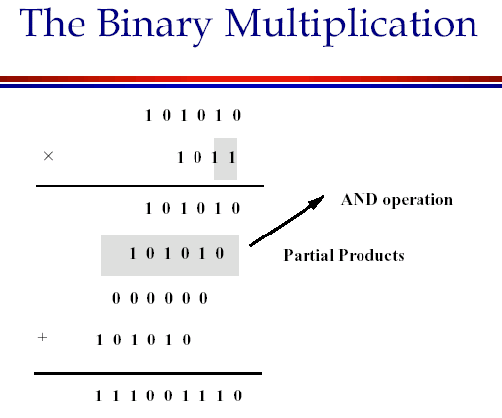

Slide 28
ضرب باينري
Shift-and-add algorithm, as in base 10
Check: 13 * 6 = 78
M’cand | 0 | 0 | 0 | 1 | 1 | 0 | 1
M’plier | 0 | 0 | 0 | 0 | 1 | 1 | 0
(1) |  |  | 0 | 0 | 0 | 0 | 0
(2) |  | 0 | 1 | 1 | 0 | 1
(3) | 0 | 1 | 1 | 0 | 1
Sum | 1 | 0 | 0 | 1 | 1 | 1 | 0

Slide 29
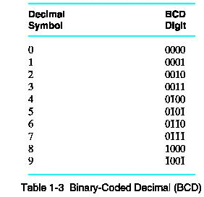
Binary-Coded Decimal (BCD)
A decimal code: Decimal numbers (0..9) are coded using 4-bit distinct binary words
Observe that the codes 1010 .. 1111 (decimal 10..15) are NOT represented (invalid BCD codes)

Slide 30
Binary-Coded Decimal
To code a number with n decimal digits, we need 4n bits in BCD
e.g. (365)₁₀ = (0011 0110 0101)_{BCD}
This is different from converting to binary, which is (365)₁₀ = (101101101)₂
Clearly, BCD requires more bits. BUT, it is easier to understand/interpret

Slide 31
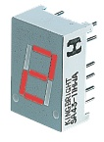
Application

Slide 32
BCD Addition
Case 1:
0001 1
0101 5
(0) 6
Case 2:
0110 6
0101 5
(1) 1
Case 3:
1000 8
1001 9
(1) 7

Slide 33
BCD Addition
Case 1:
0001 1
0101 5
(0) 0110 (0) 6
Case 2:
0110 6
0101 5
(0) 1011 (1) 1
WRONG!
Case 3:
1000 8
1001 9
(1) 0001 (1) 7
Note that for cases 2 and 3, adding a factor of 6 (0110) gives us the correct result.

Slide 34
BCD Addition (cont.)
BCD addition is therefore performed as follows
1) Add the two BCD digits together using normal binary addition
2) Check if correction is needed
a) 4-bit sum is in range of 1010 to 1111
b) carry out of MSB = 1
3) If correction is required, add 0110 to 4-bit sum to get the correct result;
→ BCD carry out = 1

Slide 35
BCD Addition (cont.)
Example: Add 448 and 489 in BCD.
0100 0100 1000 (448 in BCD)
0100 1000 1001 (489 in BCD)

Slide 36
BCD Addition (cont.)
Example: Add 448 and 489 in BCD.
0100 0100 1000 (448 in BCD)
0100 1000 1001 (489 in BCD)
10001 (greater than 9, add 6)
10111 (carry 1 into middle digit)
1101 (greater than 9, add 6)
10011 (carry 1 into leftmost digit)
1001 0011 0111 (BCD coding of 937₁₀)
0110
0110

Slide 37
BCD Negative Number Representation
Similar to binary negative number representation but for r = 10.
BCD 9’s complement
invert each BCD digit (0→9, 1 → 8, 2 → 7,3 → 6, …7 → 2, 8 → 1, 9 → 0)
BCD 10’s complement
-N ≡ 10^{n} - N; 9’s complement + 1

Slide 38
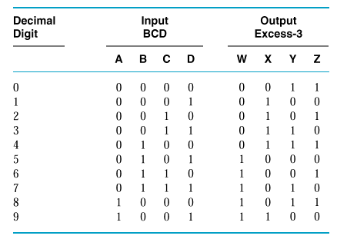
Excess-3
مانند BCD ولي هر رقم +3
جمع سرراست تر
self-comlpement code
(مکمل هر رقم = مکمل 9 آن)

Slide 39
ASCII character code
We also need to represent letters and other symbols → alphanumeric codes
ASCII = American Standard Code for Information Interchange. Also known as Western European
It contains 128 characters:
94 printable ( 26 upper case and 26 lower case letters, 10 digits, 32 special symbols)
34 non-printable (for control functions)
Uses 7-bit binary codes to represent each of the 128 characters

Slide 40
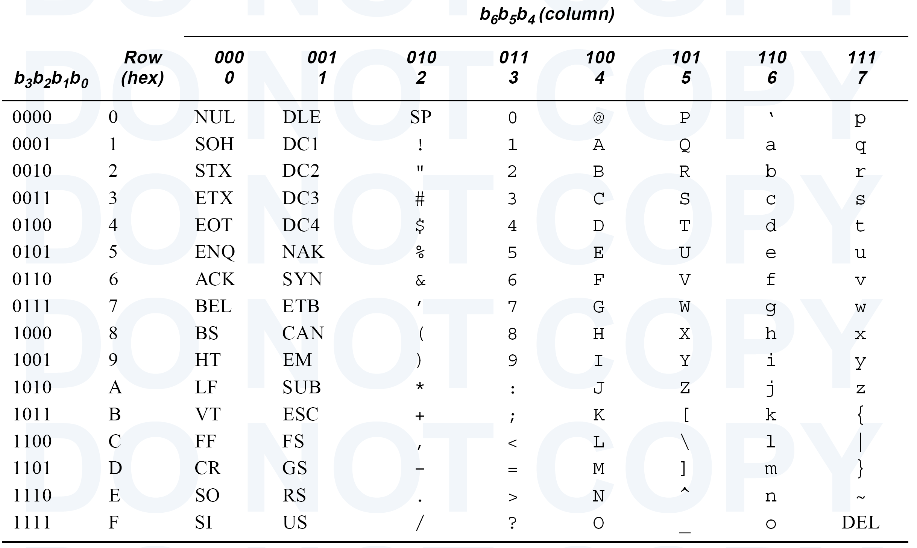
ASCII Table
Null
Space
Bell
BkSpc
Tab
Line Fd
Escape
Crg Ret

Slide 41
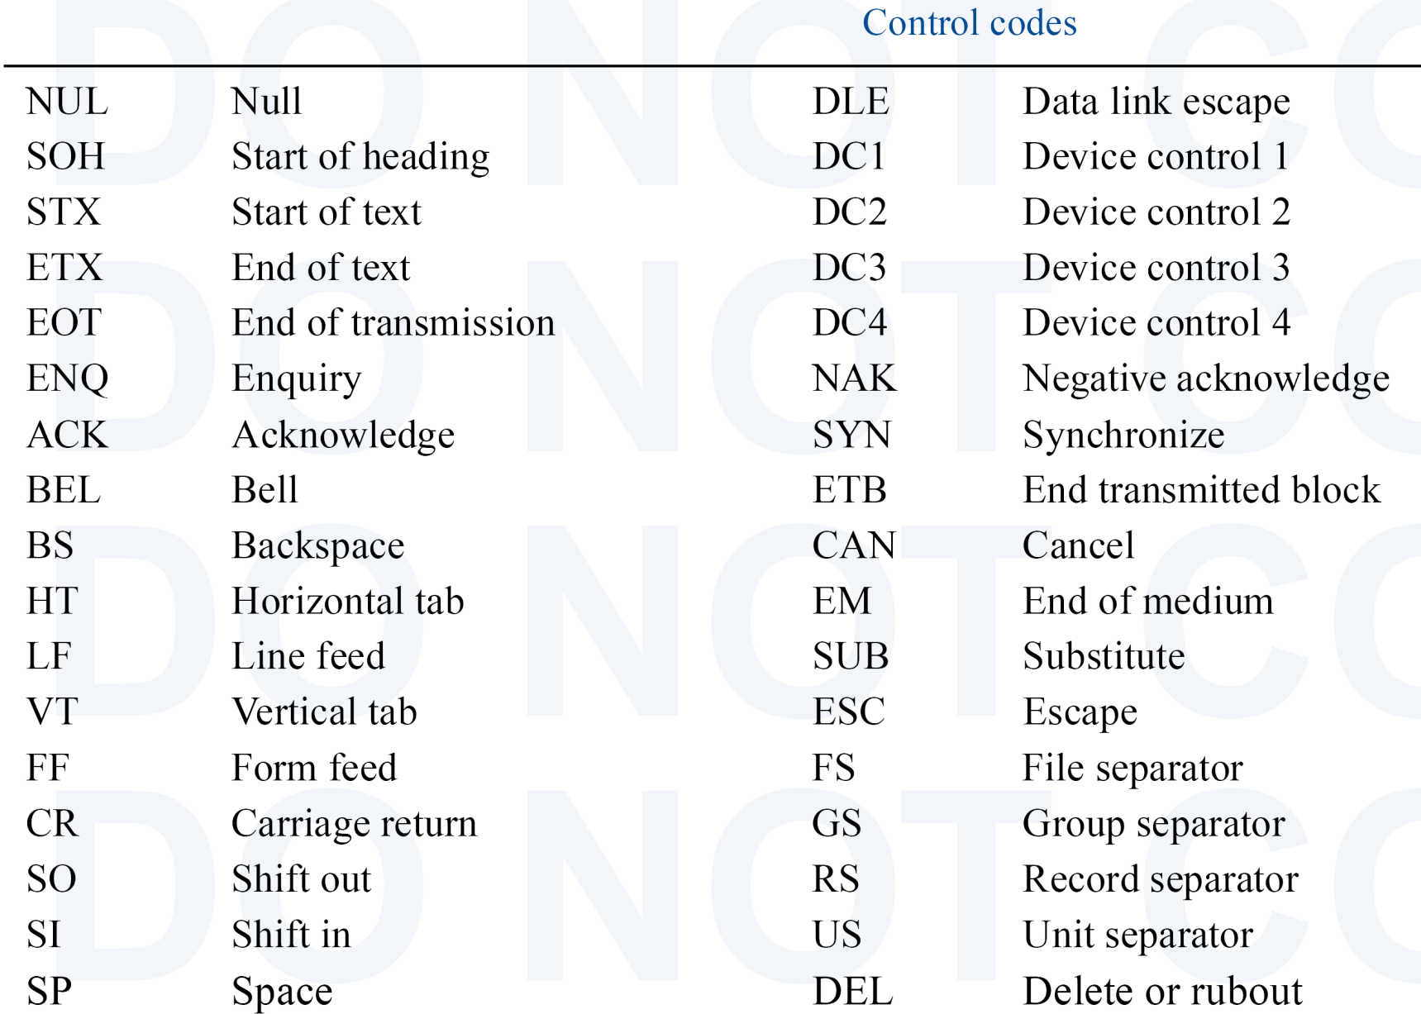
ASCII Control Codes

Slide 42
Unicode
Established standard (16-bit alphanumeric code) for international character sets
Since it is 16-bit, it has 65,536 codes
Represented by 4 Hex digits
ASCII is between 0000₁₆ .. 007B₁₆

Slide 43
Unicode Table
http://www.unicode.org/charts/

Slide 44
Unicode
062B 1579 | ث | 062C 1580 | ج | 062D 1581 | ح | 062E 1582 | خ
0633 1587 | س | 0634 1588 | ش | 0635 1589 | ص | 0636 1590 | ض
063B 1595 | ػ | 063C 1596 | ؼ | 063D 1597 | ؽ | 063E 1598 | ؾ
0643 1603 | ك | 0644 1604 | ل | 0645 1605 | م | 0646 1606 | ن
064B 1611 | ً | 064C 1612 | ٌ | 064D 1613 | ٍ | 064E 1614 | َ
0653 1619 | ٓ | 0654 1620 | ٔ | 0655 1621 | ٕ | 0656 1622 | ٖ
065B 1627 | ٛ | 065C 1628 | ٜ | 065D 1629 | ٝ | 065E 1630 | ٞ
0663 1635 | ٣ | 0664 1636 | ٤ | 0665 1637 | ٥ | 0666 1638 | ٦
066B 1643 | ٫ | 066C 1644 | ٬ | 066D 1645 | ٭ | 066E 1646 | ٮ
0673 1651 | ٳ | 0674 1652 | ٴ | 0675 1653 | ٵ | 0676 1654 | ٶ
067B 1659 | ٻ | 067C 1660 | ټ | 067D 1661 | ٽ | 067E 1662 | پ
0683 1667 | ڃ | 0684 1668 | ڄ | 0685 1669 | څ | 0686 1670 | چ
068B 1675 | ڋ | 068C 1676 | ڌ | 068D 1677 | ڍ | 068E 1678 | ڎ

Slide 45
ASCII Parity Bit
Parity coding is used to detect errors in data communication and processing
An 8th bit is added to the 7-bit ASCII code
Even (Odd) parity: set the parity bit so as to make the # of 1’s in the 8-bit code even (odd)

Slide 46
ASCII Parity Bit (cont.)
For example:
Make the 7-bit code 1011011 an 8-bit even parity code → 11011011
Make the 7-bit code 1011011 an 8-bit odd parity code → 01011011
Error Checking:
Both even and odd parity codes can detect an odd number of error.
An even number of errors goes undetected.

Slide 47
Gray Codes
Gray codes are minimum change codes
From one numeric representation to the next, only one bit changes
Applications:
Later.

Slide 48
Gray Codes (cont.)
Binary
0000
0001
0010
0011
0100
0101
0110
0111
1000
1001
1010
1011
1100
1101
1110
1111
Gray
0000
0001
0011
0010
0110
0111
0101
0100
1100
1101
1111
1110
1010
1011
1001
1000
Binary
00
01
10
11
Gray
00
01
11
10
Binary
000
001
010
011
100
101
110
111
Gray
000
001
011
010
110
111
101
100

